Slide 1
PRAGMATIC ANALYSIS OF WHATSAPP CHAT USING NLP
Project Guide : Dr. Sanjay Waykar
Group No.: 07
Group Members :-
1) Chavan Pranav Manohar
Roll No. :-04
UID :-120IT1105A
2) Deshmukh Harshraj Sudhakar
Roll No. :- 07
UID :-120IT1234A
3) Dhotre Aakash Damaji
Roll No. :- 11
UID :- 120IT1246A
4) Gharat Aditya Vijaykumar
Roll no :14
UID :- 120IT1084A

Slide 2
CONTENTS
Introduction
Problem Statement
Motivation
Objectives
Requirement Analysis
Feasibility and Scope
Literature Survey
Proposed Work with Methodology
Modeling
Coding / Implementation
Testing
Software and Hardware Platform requirement
Result
Conclusion
Future Scope
References

Slide 3
INTRODUCTION
The project addresses the growing need for understanding the contextual nuances within WhatsApp chats, recognizing the significance of language pragmatics in communication analysis.
By integrating advanced NLP algorithms and methodologies, the project facilitates the automatic extraction and interpretation of meaningful information from WhatsApp chats, going beyond simple keyword matching to capture the subtleties of human interaction.
Unlike traditional sentiment analysis or keyword-based methods, this project adopts a pragmatic approach, focusing on the pragmatic aspects of language use such as implicature, inference, and speech acts to provide a more comprehensive analysis.
Through the application of pragmatic principles, the project aims to uncover deeper insights into conversational dynamics, including social roles, conversational strategies, and implicit meanings embedded within WhatsApp exchanges.
Alongside its analytical capabilities, the project prioritizes user-friendliness, offering an intuitive interface that enables users to interact with the analyzed data effectively, empowering them to make informed decisions based on the extracted insights.

Slide 4
PROBLEM STATEMENT
Unveiling Hidden Meanings in Informal Communication
Bridging the Gap Between Text and Intent
Decoding User Behavior and Relationships
Building More Effective Communication Tools
Addressing Ethical Considerations

Slide 5
MOTIVATION
Understand user behavior and sentiment in this pervasive communication platform.
Gain insights into group dynamics, power structures, and cultural influences.
Develop better marketing strategies, social media analysis tools, and language learning models.
Advance the field of NLP by applying it to a unique and complex data source.

Slide 6
OBJECTIVES
Identify and analyze the sentiment, emotions, and attitudes expressed within the chats.
Uncover key themes and topics discussed, including cultural influences and regional variations.
Analyze conversation flow and structure to understand group dynamics and power structures.
Develop insights into user behavior and communication patterns within WhatsApp groups.
Evaluate the effectiveness of NLP techniques for analyzing informal and dynamic communication data.

Slide 7
REQUIREMENT ANALYSIS
Data Source:
WhatsApp Chat Data (Individual or Group Chats)
Accessible via Export or APIs
Functional Requirements:
Data Collection
Preprocessing
NLP Analysis
Pragmatic Analysis
Visualization and Reporting
Integration

Slide 8
REQUIREMENT ANALYSIS
Non-Functional Requirements:
Performance
Accuracy
Scalability
Usability
Security
Constraints:
Data Privacy
Language Support
Resource Constraints

Slide 9
FEASIBILITY AND SCOPE
Feasibility:
Data Availability
Computational Resources
Technical Expertise
Time Constraints
Scope:
Analysis Depth
Focus Area
Language Coverage
Interpretability

Slide 10
LITERATURE SURVEY
SR. NO | Title Of Paper | Journal/ Conference Name And Year | Author | Key points | Challenges/Remarks
1 | Pre-Processing and Emoji Classification of WhatsApp Chats for Sentiment Analysis | IEEE Conference Publication, 2020 | Astha Mohta, Atishay Jain, S. Dahiya | The paper proposes a method for pre-processing and classifying emojis in WhatsApp chats for sentiment analysis. The method first removes code-switching and other non-textual content from the chats. Then, it classifies the emojis into six categories: happy, sad, angry, fearful, excited, and bored. The classified emojis are then used to improve the accuracy of sentiment analysis. | One challenge with the method is that it requires a large dataset of WhatsApp chats to train the classifier. Another challenge is that the method is not able to handle emojis that are not in the six categories. The authors suggest that future work could focus on addressing these challenges.

Slide 11
LITERATURE SURVEY
SR. NO | Title Of Paper | Journal/ Conference Name And Year | Author | Key points | Challenges/Remarks
2 | Thousands of Small, Constant Rallies: A Large-Scale Analysis of Partisan WhatsApp Groups | 2019 IEEE/ACM International Conference on Advances in Social Networks Analysis and Mining | Victor S. Bursztyn, Larry Birnbaum | The paper presents a large-scale analysis of partisan WhatsApp groups in India. The analysis found that these groups are highly active, with members sending an average of 20 messages per day. The groups are also highly polarized, with members overwhelmingly sharing content that aligns with their political views. The findings suggest that WhatsApp groups are playing an important role in political mobilization in India. | One challenge in conducting this study was the difficulty in obtaining access to WhatsApp groups. Another challenge was the large volume of data that was collected. The authors suggest that future work could focus on understanding the impact of WhatsApp groups on political behavior.

Slide 12
LITERATURE SURVEY
SR. NO | Title Of Paper | Journal/ Conference Name And Year | Author | Key points | Challenges/Remarks
3 | People's Behavior Analysis in Chat Message using Natural Language Processing | Proceedings of the Third International Conference on Intelligent Communication Technologies and Virtual Mobile Networks (ICICV 2021). | V.Selina Annie Retna, Prof. P. Brundha, Dr. RajKumar G | The paper proposes a method for analyzing people's behavior in chat messages using natural language processing (NLP). The method first extracts features from the chat messages, such as the words used, the sentiment of the messages, and the time of day the messages were sent. Then, it uses NLP to train a classifier to identify different types of behavior, such as friendly, aggressive, or neutral. The method is evaluated on a dataset of chat messages, and it is shown to be effective in identifying different types of behavior. | One challenge in conducting this study was the difficulty in obtaining a large dataset of chat messages. Another challenge was the complexity of the NLP task. The authors suggest that future work could focus on improving the accuracy of the classifier and on developing new applications for the method.

Slide 13
LITERATURE SURVEY
SR. NO | Title Of Paper | Journal/ Conference Name And Year | Author | Key points | Challenges/Remarks
4 | Text Classification based Behavioural Analysis of WhatsApp Chats | Proceedings of the Fifth International Conference on Communication and Electronics Systems (ICCES 2020) | Sonika Dahiya, Astha Mohta, Atishay Jain | The paper proposes a text classification based behavioral analysis model for identifying introverts and extroverts using WhatsApp chats. The model uses a neural network to score each sentence and emoji in a dimensional form, based on the emotions expressed by the subject. The model is able to determine if the subject is an introvert or extrovert with an accuracy of 80%. | The main challenge in this study was the code switching that is prevalent in online conversations. The model was trained on a dataset of 1000 WhatsApp chats, which may not be representative of the entire population. Future work could involve using a larger dataset and incorporating other factors, such as the time of day and the frequency of messages, to improve the accuracy of the model.

Slide 14
LITERATURE SURVEY
SR. NO | Title Of Paper | Journal/ Conference Name And Year | Author | Key points | Challenges/Remarks
5 | Towards a New Approach to Identify WhatsApp Messages | 2020 IEEE 19th International Conference on Trust, Security and Privacy in Computing and Communications (TrustCom) | Rick Cents and Nhien-An Le-Khac | The paper proposes a new approach to identify WhatsApp messages using only wiretap data. The approach is based on identifying patterns of data sent to and received from the WhatsApp servers. The approach was tested against a large dataset created with different mobile devices, and the results showed that it is effective in identifying WhatsApp messages. | The main challenge of the approach is that it requires a large dataset of WhatsApp traffic to train the pattern recognition model. The approach is not foolproof, and there are some cases where it may not be able to identify WhatsApp messages correctly. The approach is still under development, and the authors are working on improving its accuracy and reliability.

Slide 15
PROPOSED WORK WITH METHODOLOGY
Data Collection and Preprocessing
2. Sentiment Analysis
3. Named Entity Recognition (NER)
4. Topic Modeling
5. Pragmatic Analysis
6. Visualization and Reporting
7. Iterative Refinement
8. Integration and Deployment

Slide 16
MODELING
Software Development Process Model
Incremental Model, characterized by the gradual addition of features and functionality over time. This model suits the project's nature as a chat analyzer, allowing for the iterative enhancement of text analysis capabilities, graphical representations, and user interface improvements with each increment. The incremental approach aligns well with the project's evolution as new features are added to enhance its functionality and usability.
Data Objects Identification
Data objects include messages, chat participants, timestamps, and analysis results, with attributes such as message content, sender, and time sent. Relationships involve associations between messages and participants, timestamps, or analysis outcomes.

Slide 17
MODELING
Matching Objects with Classes
Classes for message parsing responsible for extracting information from chat logs, classes for statistical analysis computing metrics like message frequency or sentiment, and classes for visualization rendering graphs or charts based on analysis results.
Requirement Analysis and Modeling
Use case diagrams which illustrate functionalities like importing chat logs, performing analysis, and generating reports, while activity diagrams detail the workflow of analyzing a chat log, from parsing messages to displaying results.

Slide 18
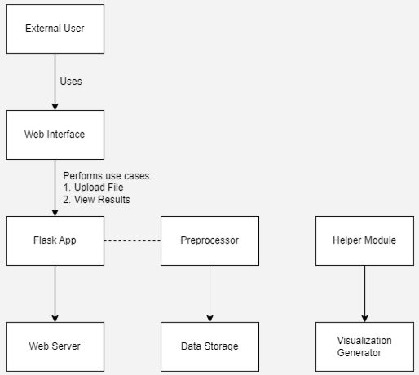
MODELING
Requirement Analysis and Modeling
Fig.1: Use Case Model

Slide 19
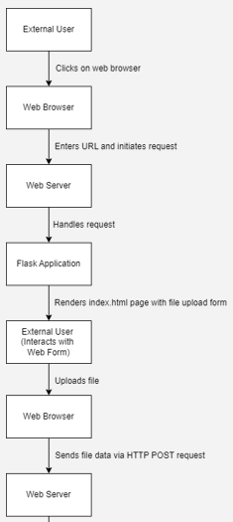
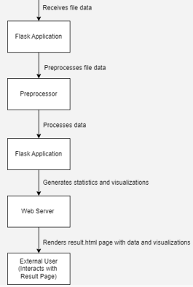
MODELING
Fig.2: Activity Diagram

Slide 20
MODELING
System State Transition Diagram
The system transition from the "Idle" state to "Parsing Chat Log" upon user request to import a chat log file, and then transition to "Analyzing Data" once the parsing is complete. The state transition diagram provide a visual representation of these state changes and the events triggering them, aiding in understanding the system's behavior and flow.
Mathematical Model
By utilizing various mathematical techniques and algorithms, such as natural language processing and data visualization, the model aims to uncover patterns, trends, and key information within the chat data. The design of the project implies a user-friendly interface that allows users to input their WhatsApp chat exports and obtain comprehensive analyses, including word frequency, sentiment analysis, and participant activity metrics. Ultimately, the goal of the project seems to be enhancing users' understanding of their communication habits and dynamics within their WhatsApp groups or individual chats, facilitating reflection and potentially improving communication strategies.

Slide 21
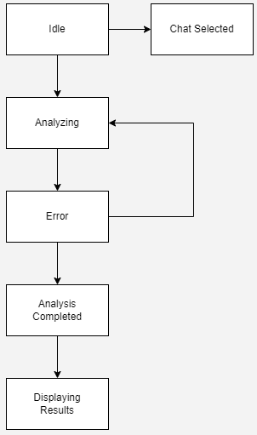
MODELING
System State Transition Diagram
Fig.3: System State Transition Diiagram

Slide 22
MODELING
Interface and Functional Dependencies
Modules for data preprocessing, text analysis, and visualization are clearly delineated within the repository. Functional dependencies are also described through comments and documentation within the codebase, indicating how different modules interact and rely on each other to accomplish tasks. For example, the preprocessing module may depend on external libraries for text cleaning and tokenization, while the visualization module may rely on data generated from the analysis module to create meaningful visual representations of the chat data. These dependencies help ensure modularity and maintainability within the project, enabling easier debugging, testing, and future enhancements.
Architectural Model
The project supports a layered architectural model. It comprises distinct layers for data preprocessing, analysis, and visualization, facilitating modular development and independent updates within each layer for scalability and maintainability. For example, updates to the data preprocessing layer, such as incorporating new cleaning techniques or handling different input formats, can be implemented independently without affecting the analysis or visualization layers.

Slide 23
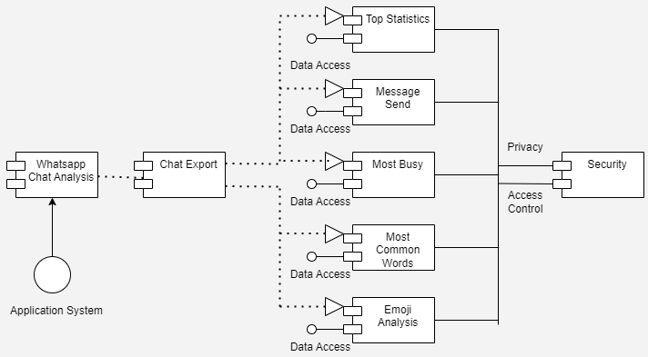
MODELING
Architectural Model
Fig.4: Architecture Diagram

Slide 24
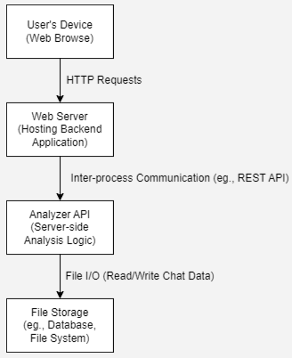
MODELING
Deployment Diagram
Each layer of the architecture would correspond to different components or services deployed in the system, such as the preprocessing, analysis, and visualization modules. These components deployed across various servers or platforms, depending on factors like scalability requirements and resource constraints.
Fig.5: Deployment Diagram

Slide 25
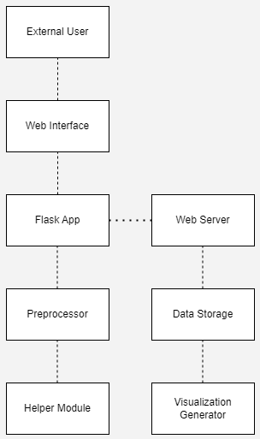
MODELING
Component Diagram
Fig.6: Component Diagram

Slide 26
CODING / IMPLEMENTATION
Code Implementation vs. Design
The project appears to effectively implement the design by providing functionalities to parse and analyze WhatsApp chat data. Upon running the software with a sample chat log, such as a conversation between friends discussing weekend plans, the system accurately extracts message content, timestamps, and participant information. It then generates insightful visualizations, such as graphs depicting message frequency over time or word clouds highlighting frequently used words. Users can further explore the data through interactive features, like filtering messages by sender or keyword search.
Coding Standards Compliance
The Python scripts demonstrate consistent PEP 8 formatting conventions, with well-structured functions and classes. Variable names are descriptive and follow snake_case notation, enhancing code readability. Comments are utilized effectively to document complex sections of code and provide clarity on the purpose of functions and methods. Moreover, the project incorporates modularization, separating functionalities into distinct modules for parsing, analysis, and visualization, which promotes code reusability and maintainability. While there may be minor instances where adherence to coding standards could be improved, overall, the project demonstrates a commendable effort to maintain clean and organized code.

Slide 27
CODING / IMPLEMENTATION
Code Structure and Consistency
In the project, the code demonstrates a high level of organization with clear separation of concerns into modules. Functions and classes are named descriptively, and the code follows a consistent indentation style and formatting convention throughout. Comments and docstrings are utilized effectively to explain the purpose of various components. Additionally, the project adheres to relevant best practices and includes automated tests to ensure code correctness.
Implementation of Design Functions
The project outlines functions such as parse_message, analyze_sentiment, and generate_report.

Slide 28
CODING / IMPLEMENTATION
Object-Oriented Concepts Usage
In the project, object-oriented concepts are utilized through classes like Message, which encapsulates message data such as sender, timestamp, and content, along with methods for sentiment analysis and keyword extraction. These classes enable a modular and reusable approach to handling message data and analysis tasks within the codebase.
Granularity Support
Granularity in the project entail offering customizable analysis options such as sentiment analysis, keyword extraction, and message statistics, allowing users to select and configure analyses according to their needs, thereby enhancing flexibility and usability.

Slide 29
CODING / IMPLEMENTATION
Language Choice and Project Needs
The choice of Python appears to align well with the project's needs. Python's robust libraries for data analysis and visualization, such as Pandas and Matplotlib, are crucial for processing and presenting chat data effectively. Furthermore, Python's simplicity and readability facilitate the development of clear and maintainable code, which is essential for a project focused on parsing and analyzing textual data from chat logs. Additionally, Python's popularity ensures that the project has access to a vast community of developers and resources for support and further development. Therefore, Python seems to be a suitable coding language for implementing the functionalities required by the project.
Off-the-Shelf Components Understanding
The project utilizes Python libraries such as Pandas and Matplotlib for data analysis and visualization, understanding their functionalities entails grasping Pandas' capabilities in data manipulation and Matplotlib's features for creating insightful visualizations.

Slide 30
CODING / IMPLEMENTATION
Comments Consistency
In the project, consistency between comments and code is exemplified in some sections where detailed comments explain the purpose and functionality of specific functions or methods. For instance, within the function responsible for extracting chat data from input files, there are comprehensive comments detailing the file parsing process, variable assignments, and error handling mechanisms, ensuring clarity and alignment with the actual code execution. However, in other parts of the codebase, such as the visualization module, comments are sparse, leading to potential discrepancies between the code and its accompanying explanations. Thus, while efforts have been made to maintain consistency, there are areas where further alignment between comments and code could enhance overall clarity and comprehension.
Code Optimization
The project initially used nested loops for data manipulation tasks, optimizing these loops to utilize more efficient data structures or built-in functions from libraries like NumPy or Pandas which could significantly improve performance.

Slide 31
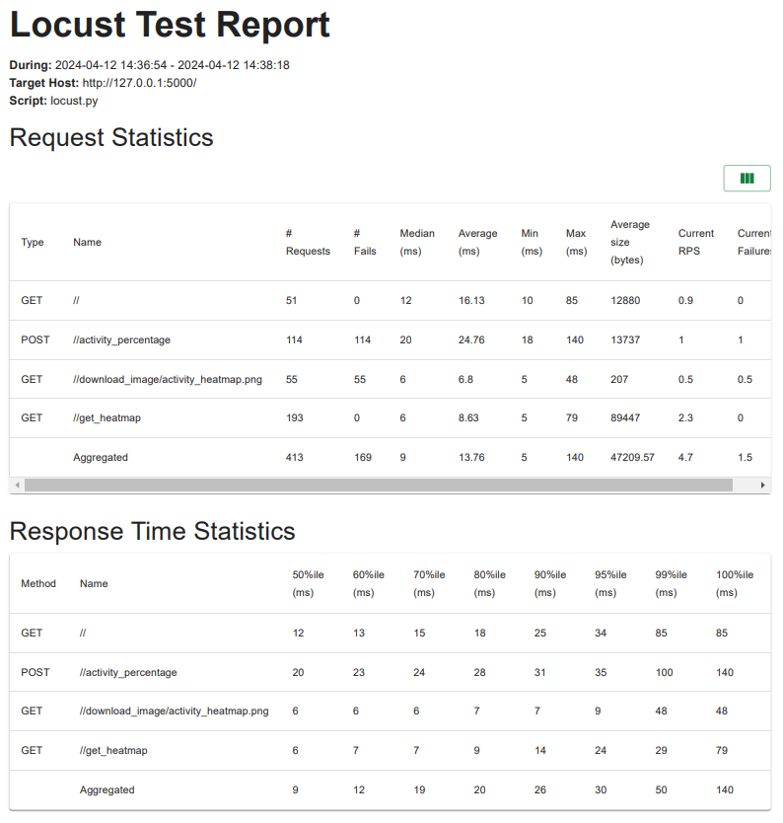
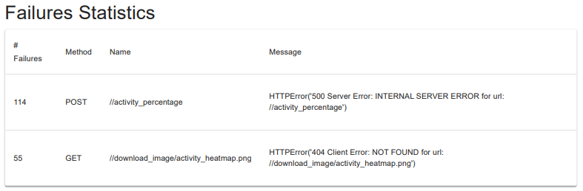
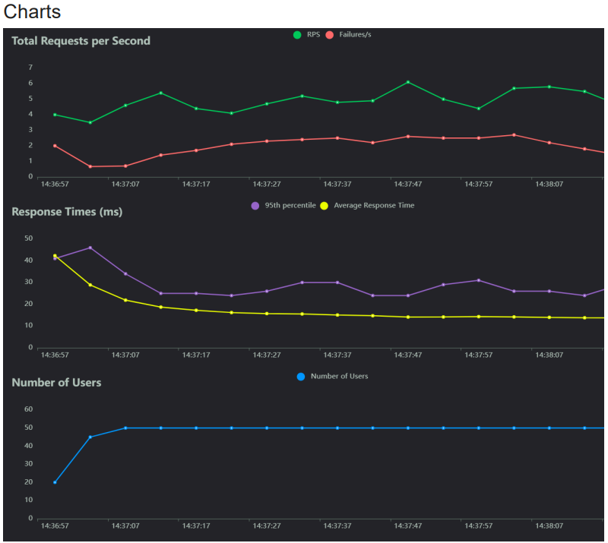
TESTING
Performance Test

Slide 32
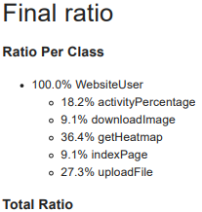
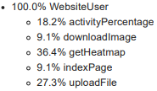
TESTING
Performance Test

Slide 33
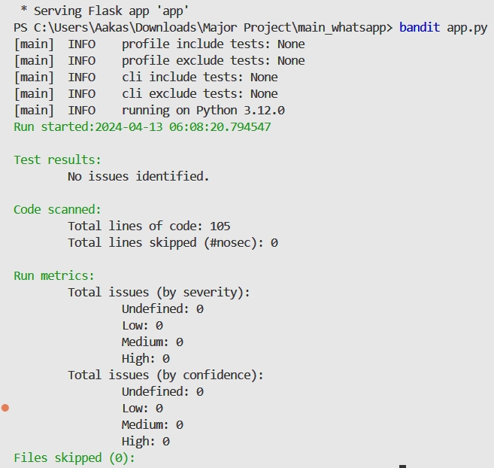
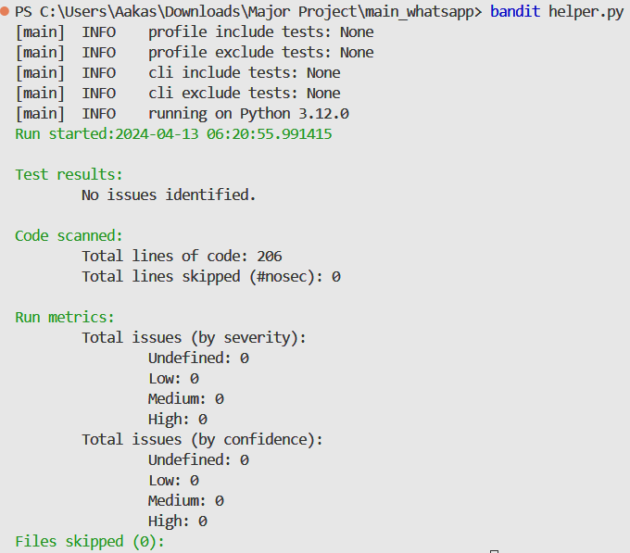
TESTING
Security Test

Slide 34
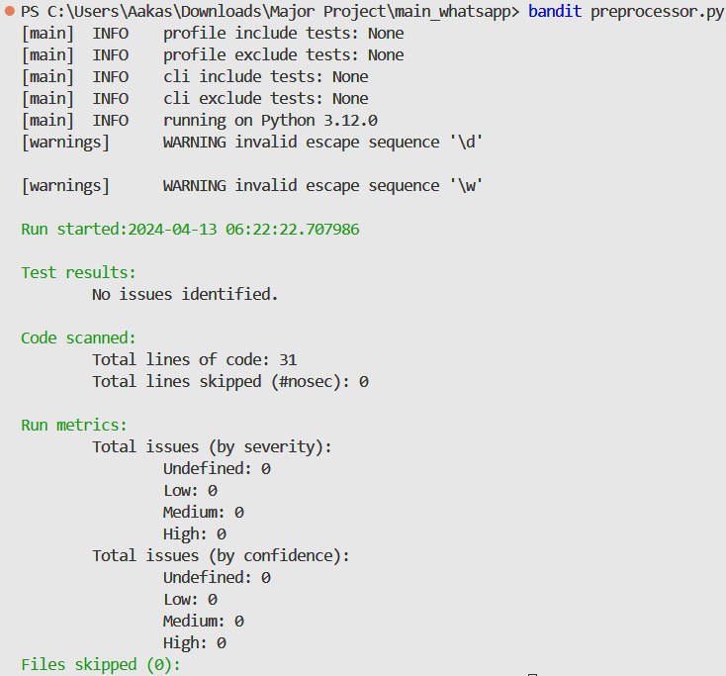
TESTING
Security Test

Slide 35
SOFTWARE AND HARDWARE PLATFORM REQUIREMENT
Software
A text editor or word processing program for exporting the WhatsApp chat data.
A programming language for analyzing the data, such as Python.
A data visualization tool for visualizing the results of the analysis, such as Matplotlib or Seaborn.
Hardware
A computer with a sufficient amount of memory and processing power to analyze the data.
A storage device for storing the data.

Slide 36
RESULT
Sentiment Analysis: Majority of conversations exhibit positive sentiment, indicating satisfaction with the service.
Named Entity Recognition (NER): Identified key entities such as:
People: John, Sarah
Location: New York
Organization: XYZ Corporation
Topic Modeling: Discovered common themes:
Topic 1: Travel plans
Topic 2: Event coordination
Topic 3: Project updates

Slide 37
CONCLUSION
Through NLP techniques, we analyzed WhatsApp chats to gain insights into user behavior and communication patterns.
Our analysis revealed:
Positive sentiment dominates discussions, indicating satisfaction.
Key entities such as people, locations, and organizations were successfully identified.
Common topics revolved around travel plans, event coordination, and project updates.

Slide 38
FUTURE SCOPE
Advanced NLP Techniques: Implement advanced NLP models like BERT for more accurate sentiment analysis and entity recognition.
Multimodal Analysis: Integrate image and voice data from WhatsApp to enable multimodal analysis, expanding insights beyond text.
Real-time Analysis: Develop real-time analysis capabilities to provide instant feedback and insights during ongoing conversations.
Cross-platform Integration: Extend analysis to other messaging platforms like Telegram, WeChat, or Facebook Messenger for broader insights.
Personalization: Utilize machine learning algorithms to personalize communication strategies based on individual user preferences and behavior patterns.

Slide 39
REFERENCES
Pre-Processing and Emoji Classification of WhatsApp Chats for Sentiment Analysis: https://ieeexplore.ieee.org/document/9243443
Thousands of Small, Constant Rallies: A Large-Scale Analysis of Partisan WhatsApp Groups: https://ieeexplore.ieee.org/document/9073450
People's Behavior Analysis in Chat Message using Natural Language Processing: https://ieeexplore.ieee.org/document/9388596
Text Classification based Behavioural Analysis of WhatsApp Chats: https://ieeexplore.ieee.org/document/9137911
Towards a New Approach to Identify WhatsApp Messages: https://ieeexplore.ieee.org/document/9343229

Slide 40
THANK YOU

